Slide 1
Glossy sun
E.Z.A.Y Team
The challenge: You Are My Sunshine
Our Team’s Invitation Code: dd1ee
Team Members:
Ahmed Ramy – Esraa Mohammed – Yaser Mahmoud – Abdelaziz Mohammed
Branch: NASA Space Apps EL -Minia

Slide 2
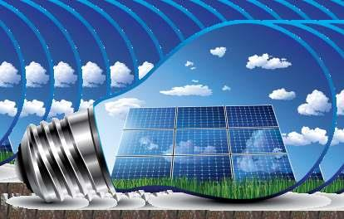
About the challenge
Our challenge that NASA’s solar and meteorological data is difficult for the public to access, That is because of the complexity of this data, and it is not easy to understand by laypeople, and it is affecting sustainable development and people’s use of clean energy.

Slide 3
goals
The three main goals for the project:
1st point: Provide useful information related to sunlight in a simple way.
2nd point: The application provides graphs of average monthly solar irradiance for the last year.
3rd point: The application makes it easy for the user to access information by his area of residence’s postal code.
1- Create a deeper understanding of the importance of solar energy.
2- Analyze NASA POWER’s data into simple graphs.
3- Integrating spatial and environmental information to make understanding clearer.

Slide 4
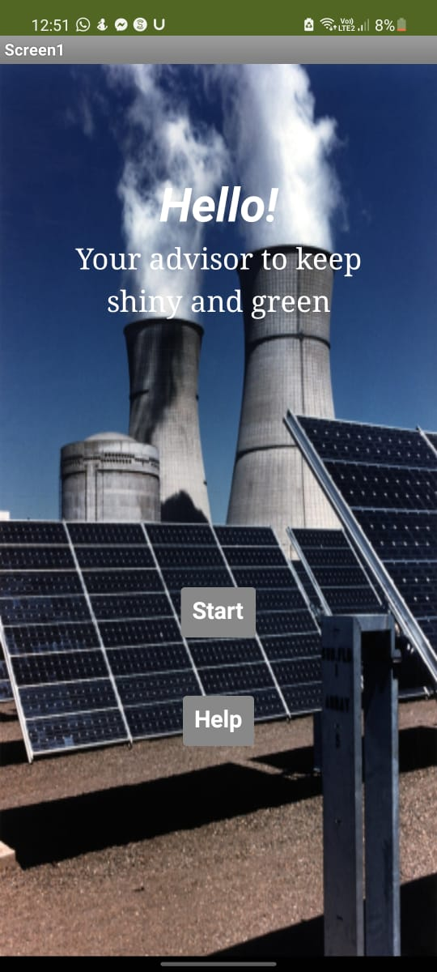
How the app work ?
Our project mainly focuses on Cairo governorate in Egypt. The project provides information on 3 aspects- solar fluxes, wind and temperature- in different urbans and suburbans around Cairo. According to these aspects and data, the user will be able to identify the best place to set a solar panels in cairo by examining the amount of sunlight that this area receives annually and examining the temperature occurs. These informations have collected from NASA POWER website around Cairo in the term of graphs. Moreover, the application also provides useful informations about solar and renewable energy for the public from different sources and international journals in the United states of America.

Slide 5
REFerences & Tools
1- NASA POWER
2- Our world is data
3-https://www.energy.gov/solar
4- New York Times
5- Sciencing.com
6- mit app inventor
7- Pngtree
8- Photoshop

Slide 6
Why is our project important ?
Our app allows users to have simple, easy access to solar information that will help a lot of people in the future turn to solar and that will benefit sustainable development projects that's the ultimate goal. In addition to further development and further professional work on the application in the future, solar data for all the world's cities can be made much easier and faster.

Slide 7
Thanks

